Slide 1
IVV Lasso Regression Model
Course: APS 1052 Group Members: Javert Zhang, Rui Zhang, Shreya Patki, Michelle Cheng
Date: December 22, 2021

Slide 2
Introduction to Seed:
For our project, the seed program we based our code off of was from the Machine Learning and Data Science Blueprints for Finance by Hariom Tatsat.
Model: Chapter 5 Case Study 1: Stock Price Prediction
Summary of model: The model uses similar stock and ETF data to predict Microsoft returns. Technical indicators like Talib are not used. The models are compared according to test-train error. No plotting or White reality check is completed.

Slide 3
List of Improvements on Seed
Features, Pre-processing, Metrics
Model
Predicting: IVV (Using ETF data instead of stock)
Stocks: Apple, Amzn, Microsoft, JPM
ETF: QQQ, SPY
Index: S&P 500, Dow Jones,VIX
Technical Indicators/Predictors: VIX historical, Talib:( SMA, RSI,ROC,MOM),Lags,Alternative Money Flow, Put-Call Parity(possibility)
Use of EWM smoothing (pre-processing)
Metrics: Sharpe Ratio, CAGR, maxDD, maxDDD,Calmar ratio, Rho, p_val, accuracy_score
Lasso (instead of testing various models like the case study. Their study deemed lasso the best model)
GridSearchCV used to search the parameters of the Lasso like span for the smoother and the Lasso alpha.
Pipeline is also used

Slide 4
Inputs and frequency
For all 13 data files, they were all downloaded from Yahoo Finance.
Our target variable was to predict the weekly returns of the IVV (S&P500 ETF).
3 ETFs were used and daily data was downloaded starting from August 01, 2002 to November 30, 2021
SPY
DIA
IEF
Stocks
ETF
Indices
4 stocks were used and daily data was downloaded starting from August 01, 2002 to November 30, 2021
AAPL
AMZN
JPM
MSFT
3 indices were used and daily data was downloaded starting from August 01, 2002 to November 30, 2021
VIX
DIA
SP500

Slide 5
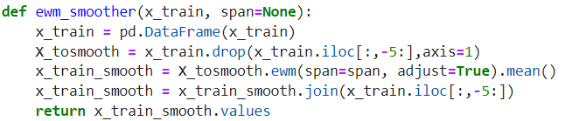
Input processing
In terms of input processing, we chose to apply exponential smoothing on our data.
We used the exponential weighted average (ewm) function built into pandas and applied this to all the lag variables within our input data.
We also chose to scale our x-variables and y-variables using the Standard Scaler function from sklearn.
No input selection was needed due to the Lasso model used.
Smoothing

Slide 6
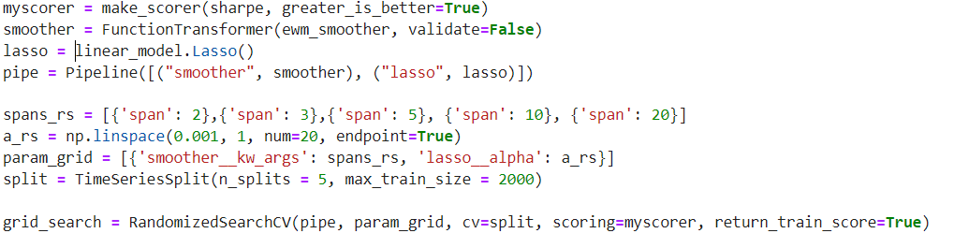
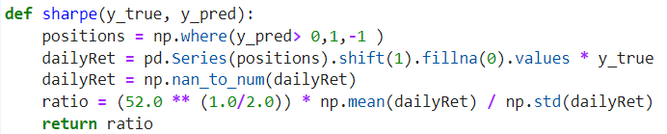
Model and Parameters
For our model, we chose to use LASSO regression to predict the weekly returns of the IVV.
Parameters:
We used the Randomized Search function to determine the optimal parameters.
We chose to cycle through different
Span values for our smoother function
Alpha values for the lasso regression
Within our Randomized Search function, we also dictated our scorer function be based off of the Sharpe Ratio and used the TimeSeriesSplit function with number of splits set to 5 and train size of 2000.
Description

Slide 7
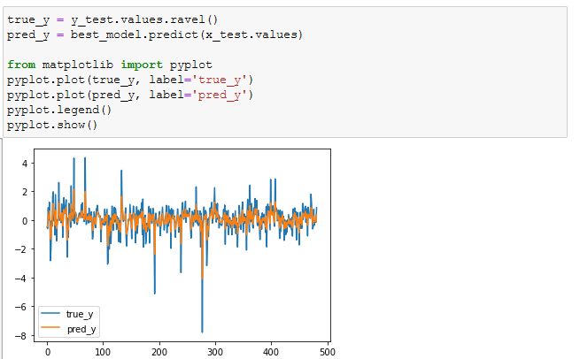
Model Results
Plotting our true y-values vs. our predicted y-values

Slide 8
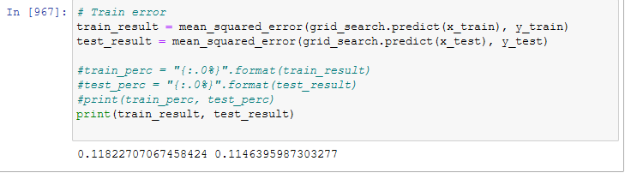
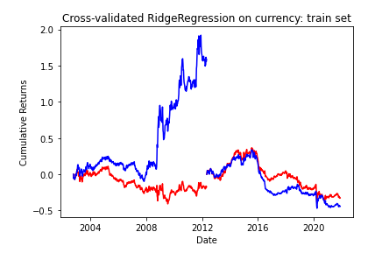
Model Results
Training vs. Testing Errors
Training error: 11.8%
Testing error: 11.4%
Both our training and testing data had relatively high error values - meaning we were underfitting our model which could be a result of high bias or high systematic error.
Equity Curves
The blue line is our prediction and the red line is the true value.
The beginning part of the chart reflects our training data and the second half of the chart reflects our testing data.

Slide 9
Metrics & White Reality Check
Here were the results we obtained from our model’s predictions
Metric (Out-of-Sample) | Results
CAGR | 0.13751
Sharpe Ratio | 1.32364
maxDD | -0.068941
maxDDD | 56
Calmar Ratio | 1.99467
Rho, p-val | 0.72085, 1.647e-20
P-value (White Reality Check) | 0.3948

Slide 10
Comparison with different model
Due to Lasso’s slightly high error, we decided to complete a addon of XGBoost model to see how the results compared. These results are summarized in the next slide.
The inputs are kept the same since we are trying to compare the model results. PCA was used to select the features as necessary.

Slide 11
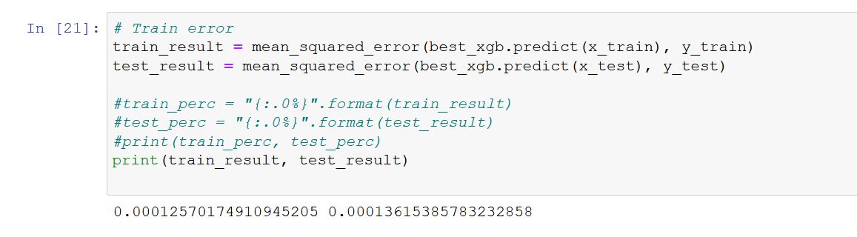
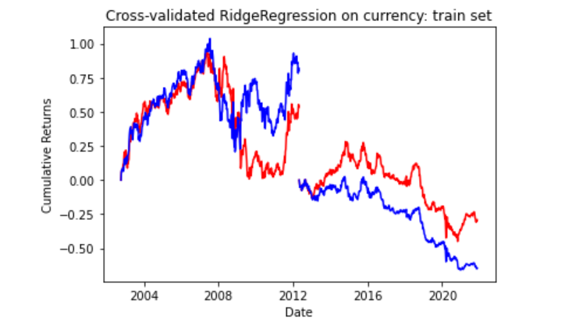
XGBoost Results
Training vs. Testing Errors
Training error: 0.0125%
Testing error: 0.0136%
As it can be seen the error is significantly lower when utilizing the XGBoost model.
Equity Curves
The blue line is our prediction and the red line is the true value.
The beginning part of the chart reflects our training data and the second half of the chart reflects our testing data.

Slide 12
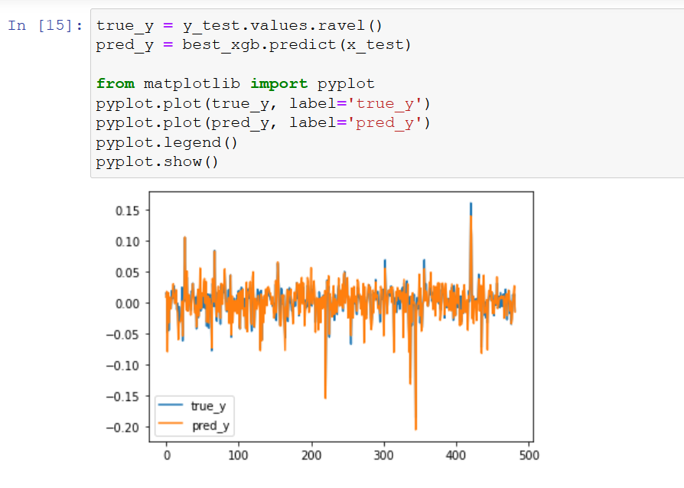
Model Results
Plotting our true y-values vs. our predicted y-values
The increased accuracy with the y points can be seen (compared to the plain Lasso model).

Slide 13
Metrics & White Reality Check (XGBoost)
Here were the results we obtained from our model’s predictions
Metric (Out-of-Sample) | Results
CAGR | -0.103
Sharpe Ratio | -0.6433
maxDD | -0.665
maxDDD | 358
Calmar Ratio | -0.154922
Rho, p-val | 0.844, 4.35*10^-132
P-value (White Reality Check) | 0.4184

Slide 14
Comparison with different model
Overall the XGBoost model is better in terms of accuracy as seen in the previous slides however, an argument can be made towards the complexity and computation cost of a model when comparing Lasso to XGBoost.

Slide 15
Thank you!

